Slide 1


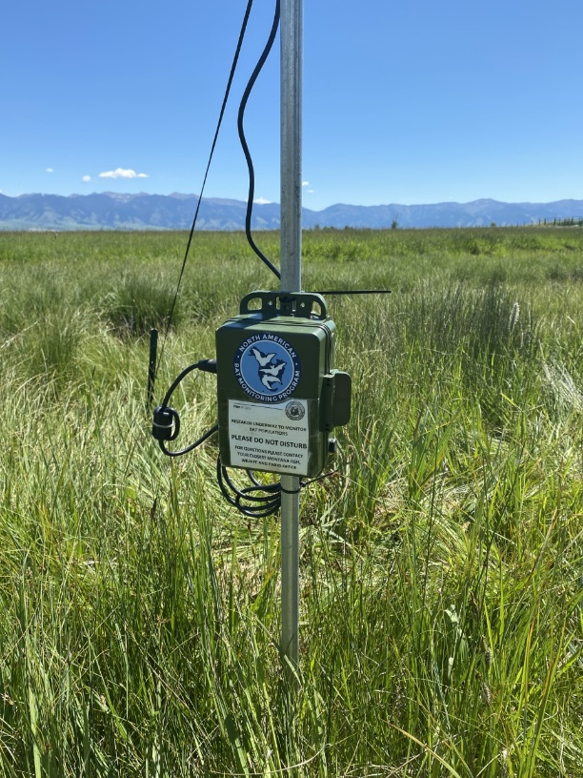
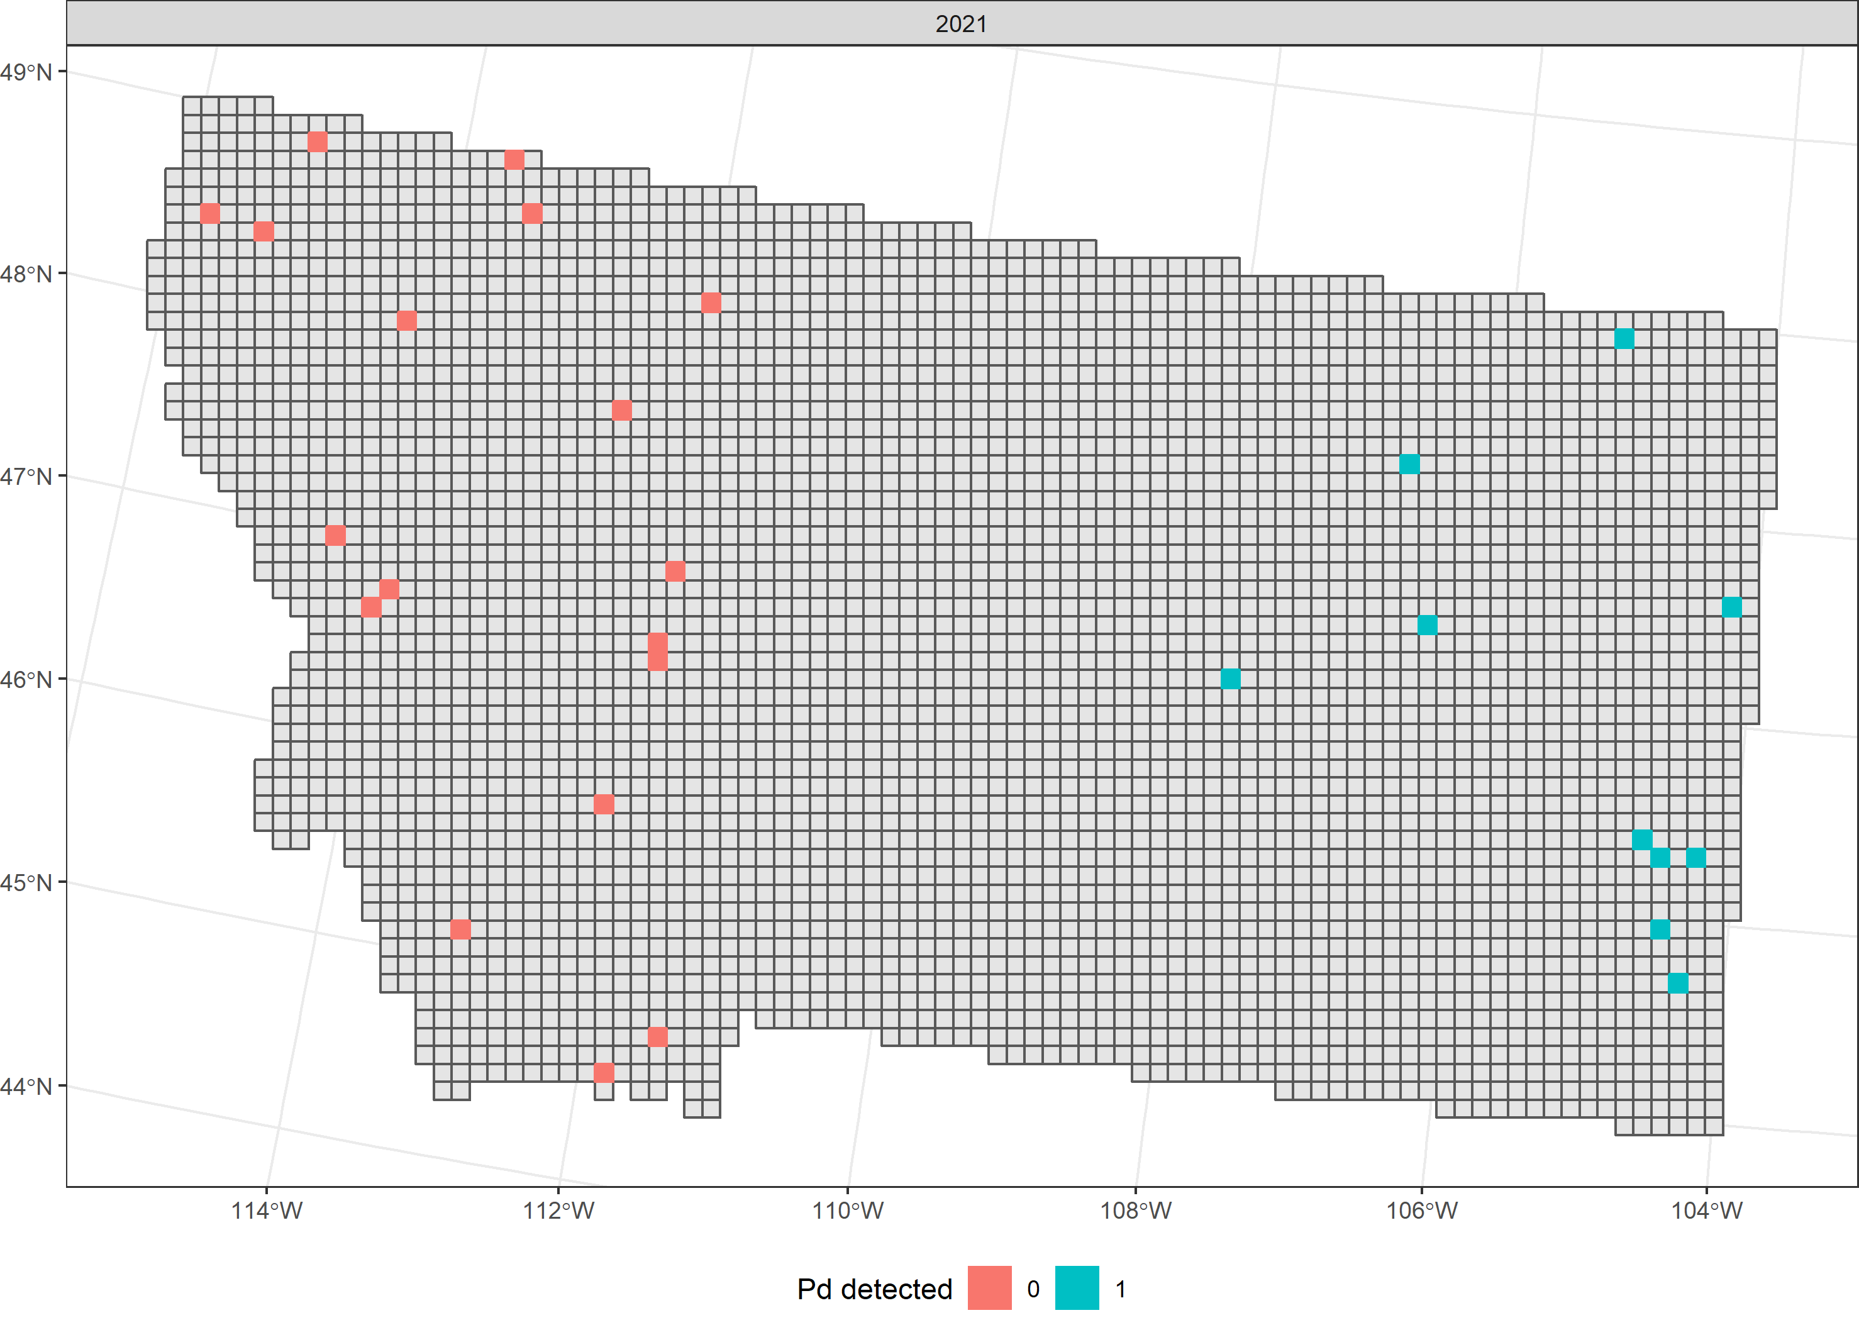
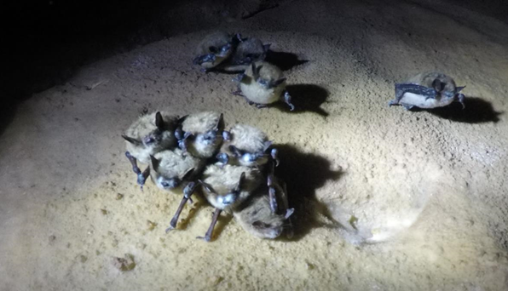
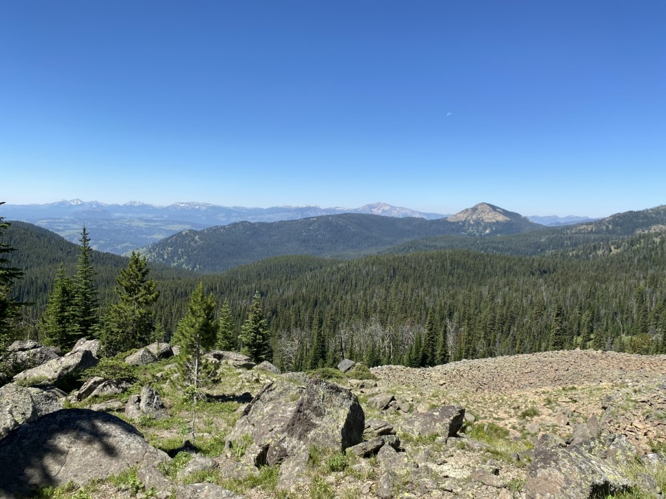
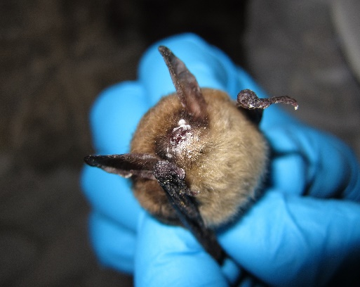
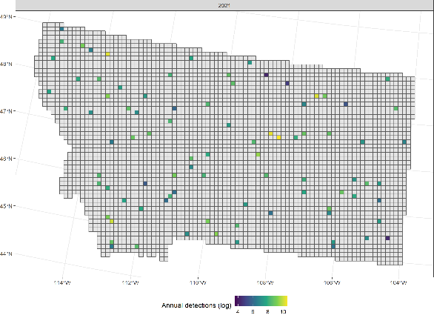
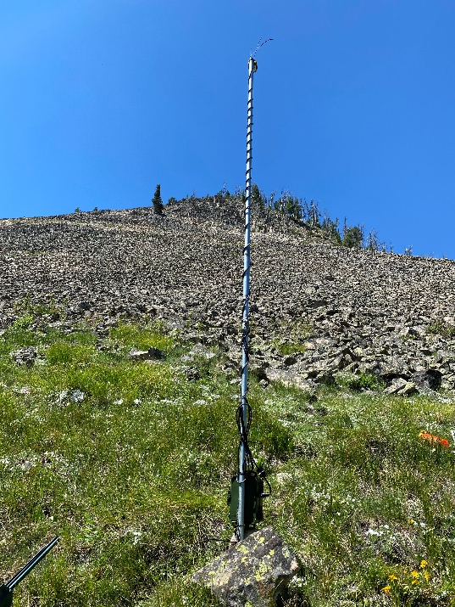
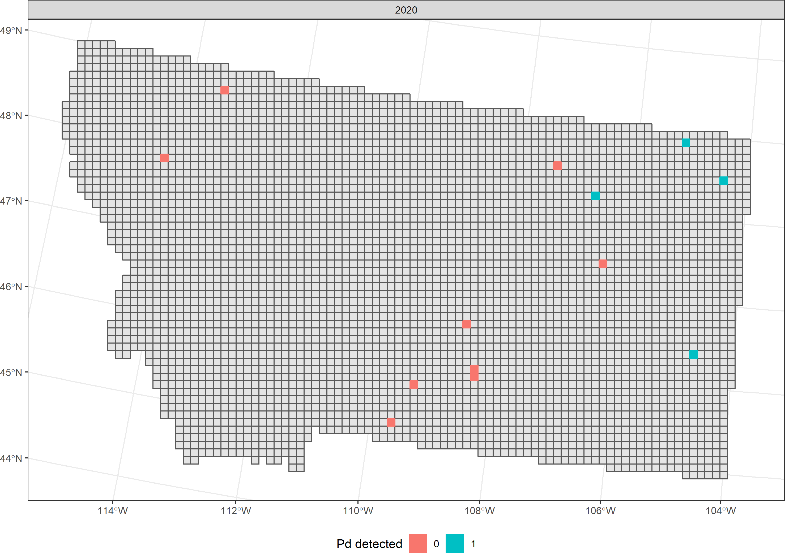
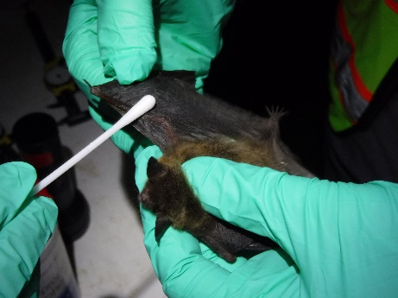
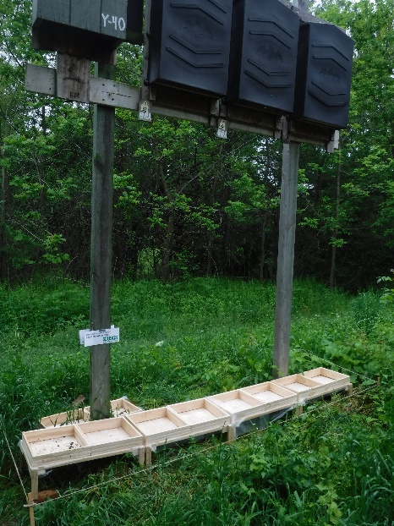
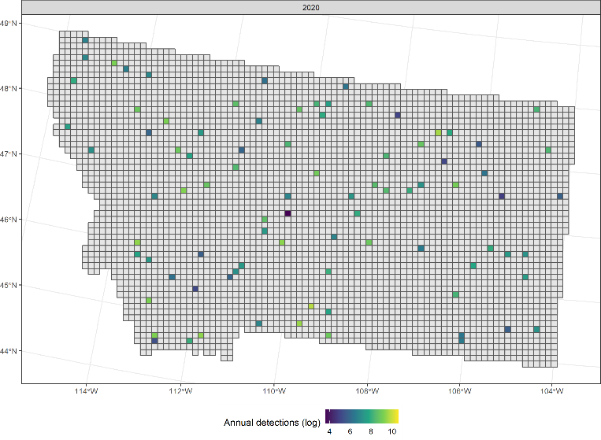
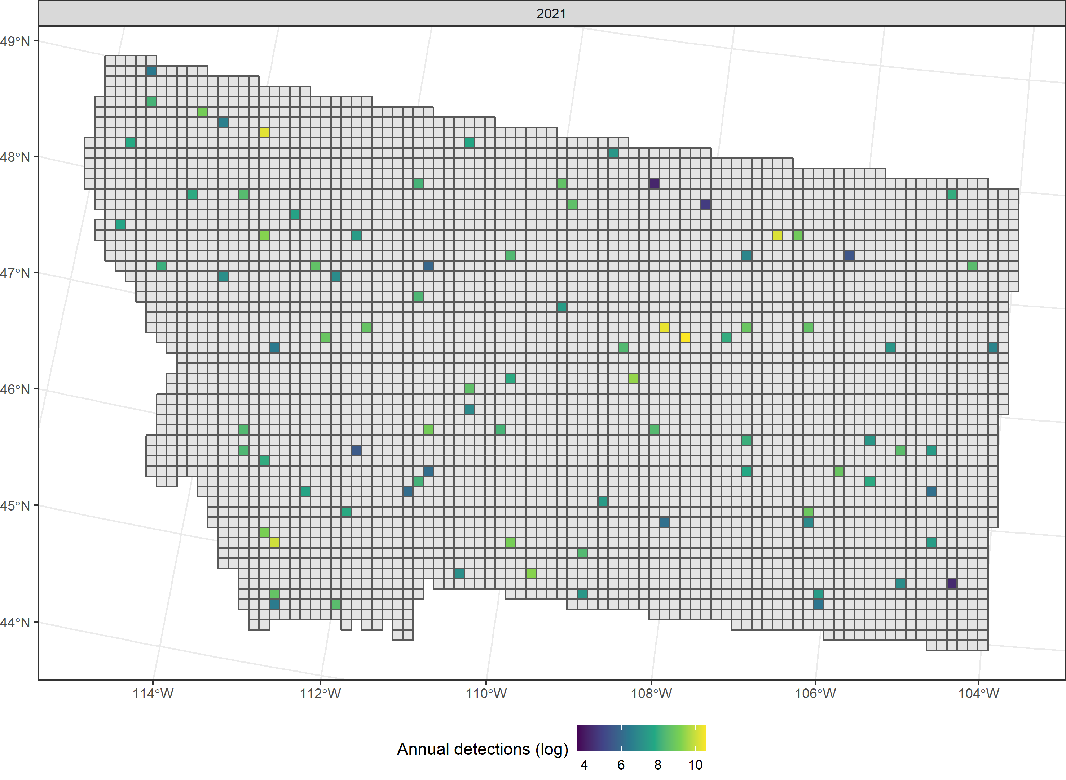
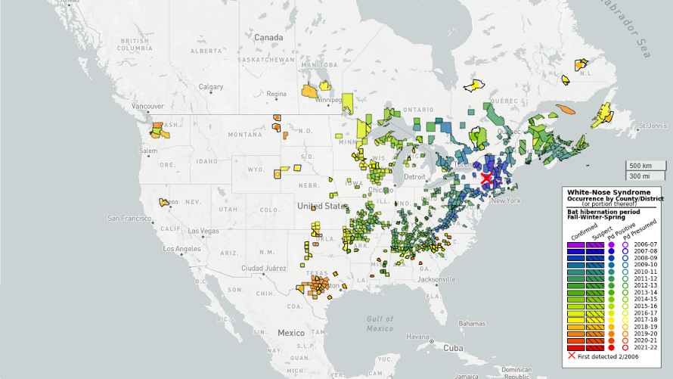
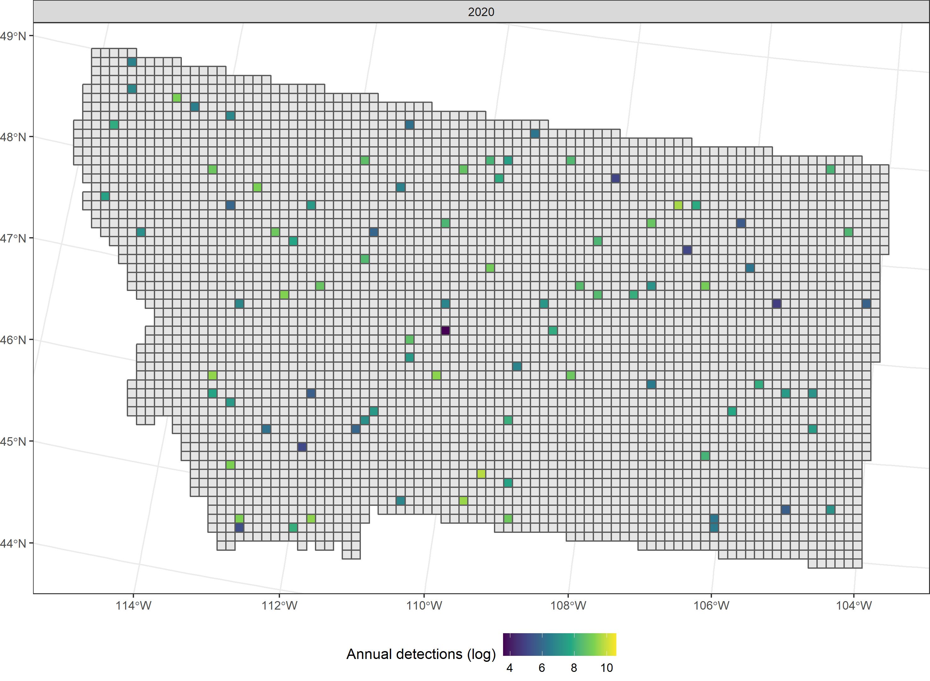
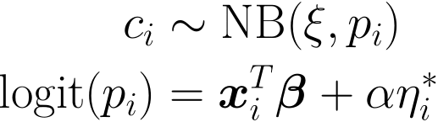
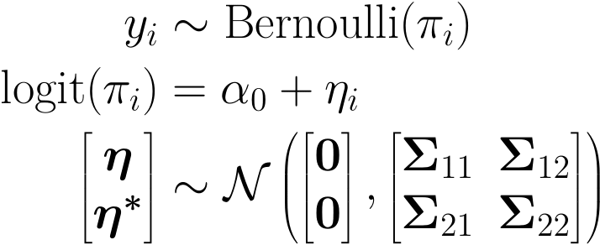
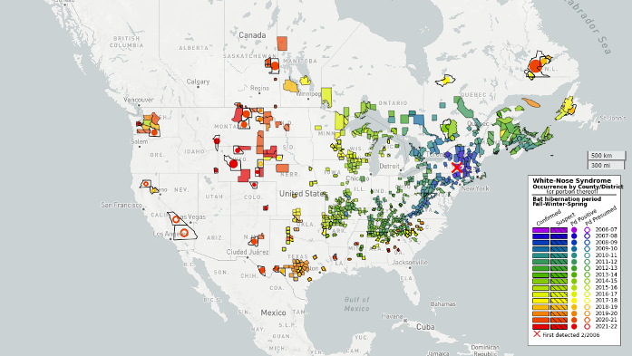

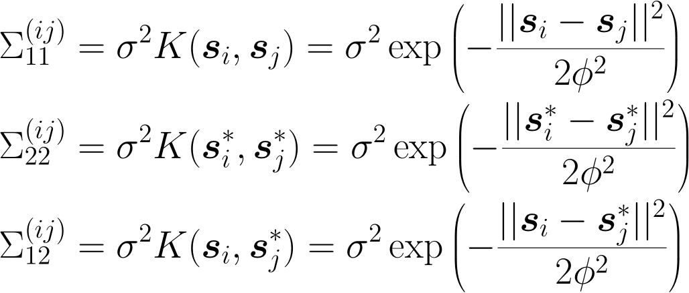
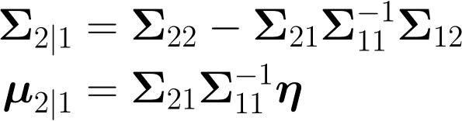
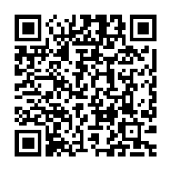
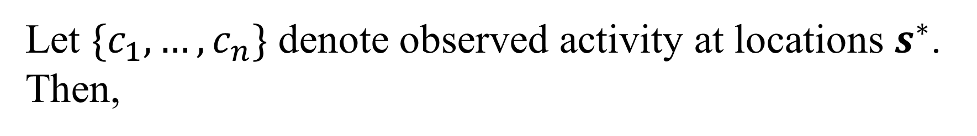
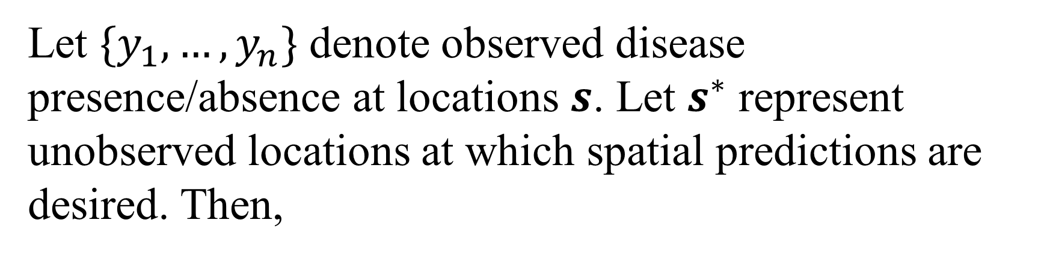
Joint spatial modeling of relative activity and disease processes
Christian Stratton, Kathryn Irvine, Emily Almberg, Kristina Smucker, Justin Gude
Motivation
Available Data
Estimation
Whitenose syndrome
Figure 1: Northern long-eared bat with visible signs of WNS (source: USFWS Flickr)
Disease caused by fungus Pseudogymnoascus destructans
Interrupts hibernation leading to starvation and dehydration
First North American detection in New York (2006)
Model Specification
Disease process model
Relative activity model
Let $\{y_{1}, …, y_{n}\}$ denote observed disease presence/absence at locations $s$. Let $s^{∗}$ represent unobserved locations at which spatial predictions are desired. Then,
Let $\{c_{1}, …, c_{n}\}$ denote observed activity at locations $s^{∗}$. Then,
Note that by properties of multivariate normal random variables,
where,
References
where,
For a list of references and author affiliations, please scan the QR code to the right.
This information is preliminary and is subject to revision. It is being provided to meet the need for timely best science. The information is provided on the condition that neither the U.S. Geological Survey nor the U.S. Government shall be held liable for any damages resulting from the authorized or unauthorized use of the information.
Notes:
Selby’s < Print me here! ☺ Save as pdf / jpeg and power point

